Slide 1
Project management executive Charts

Slide 2
Summary
Some charts here are from Jira and some have been created on excel.
To protect company confidential data all the data represented here is sample data
These were presented to stakeholders on a weekly basis

Slide 3
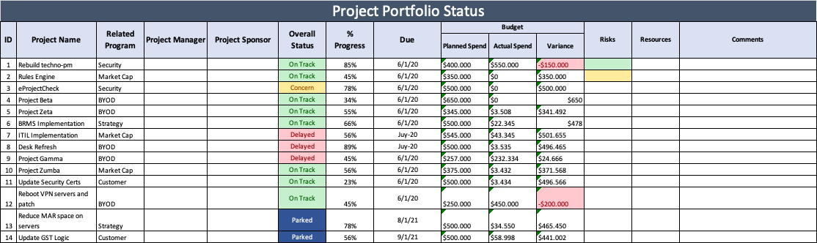
Project status

Slide 4
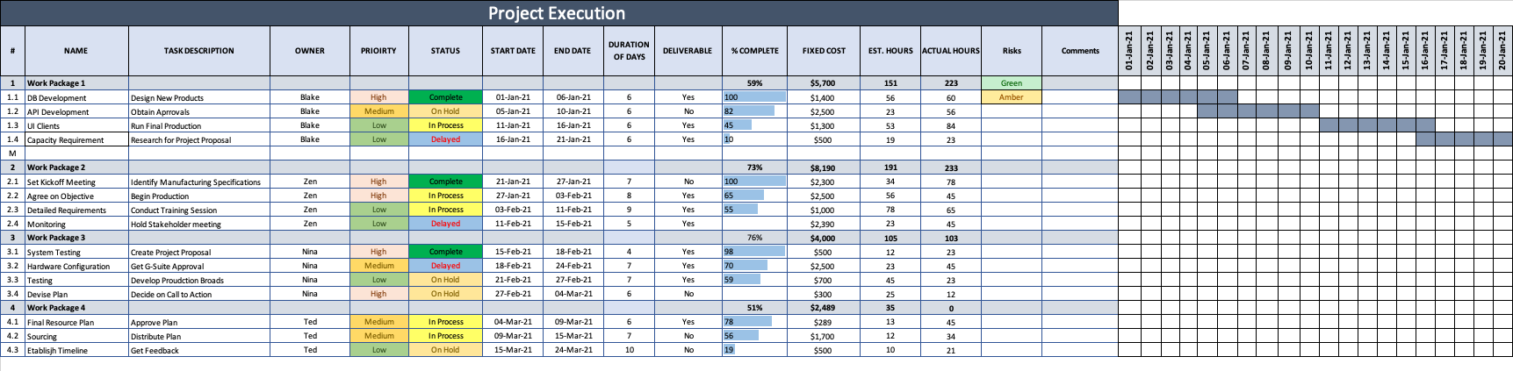
Weekly GANTT CHARTS

Slide 5
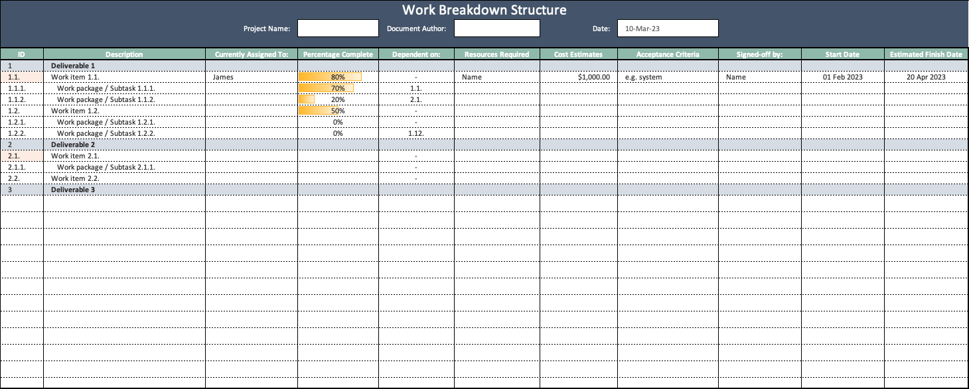
Work Breakdown Structure

Slide 6
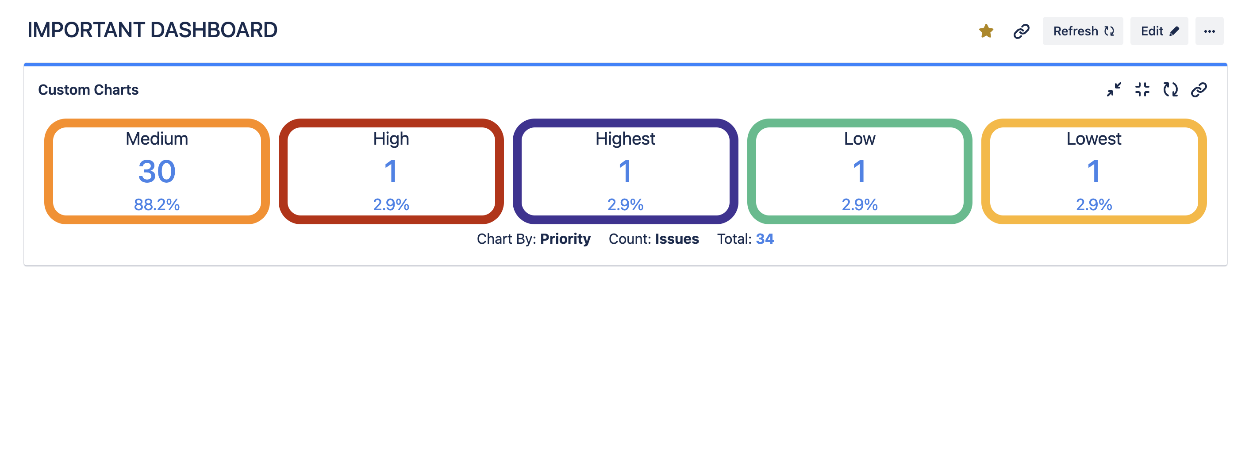
Issues arranged by priority from Jira

Slide 7
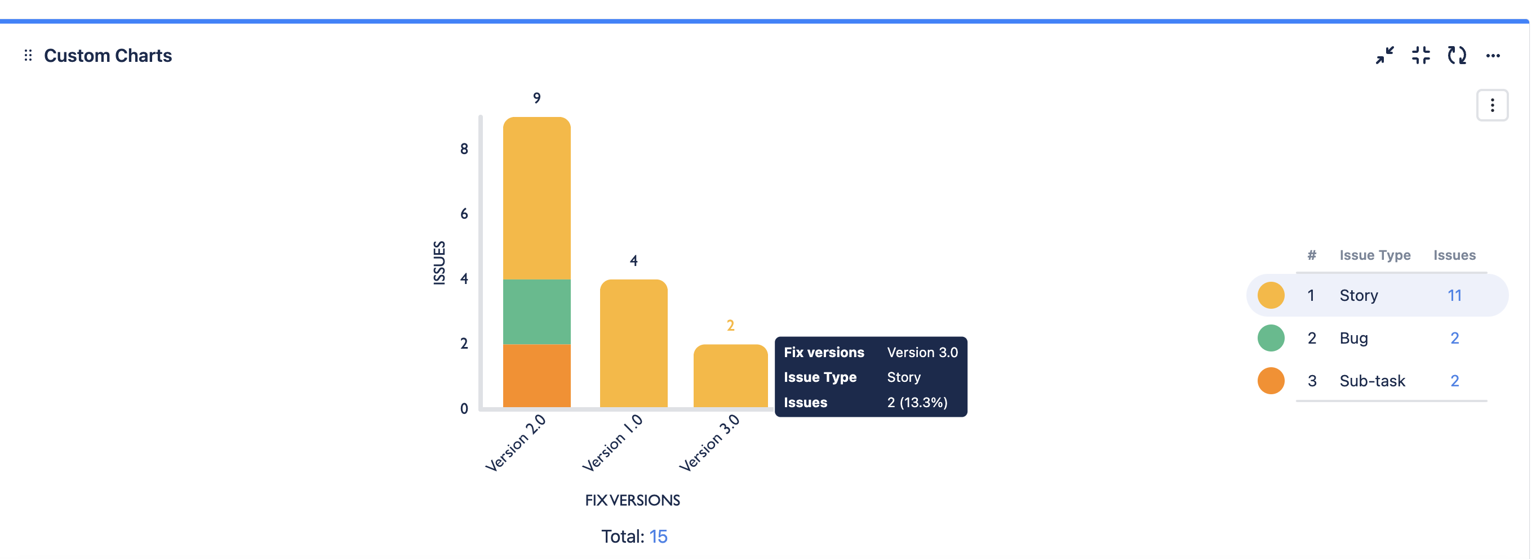
Features by version release numbers from Jira

Slide 8
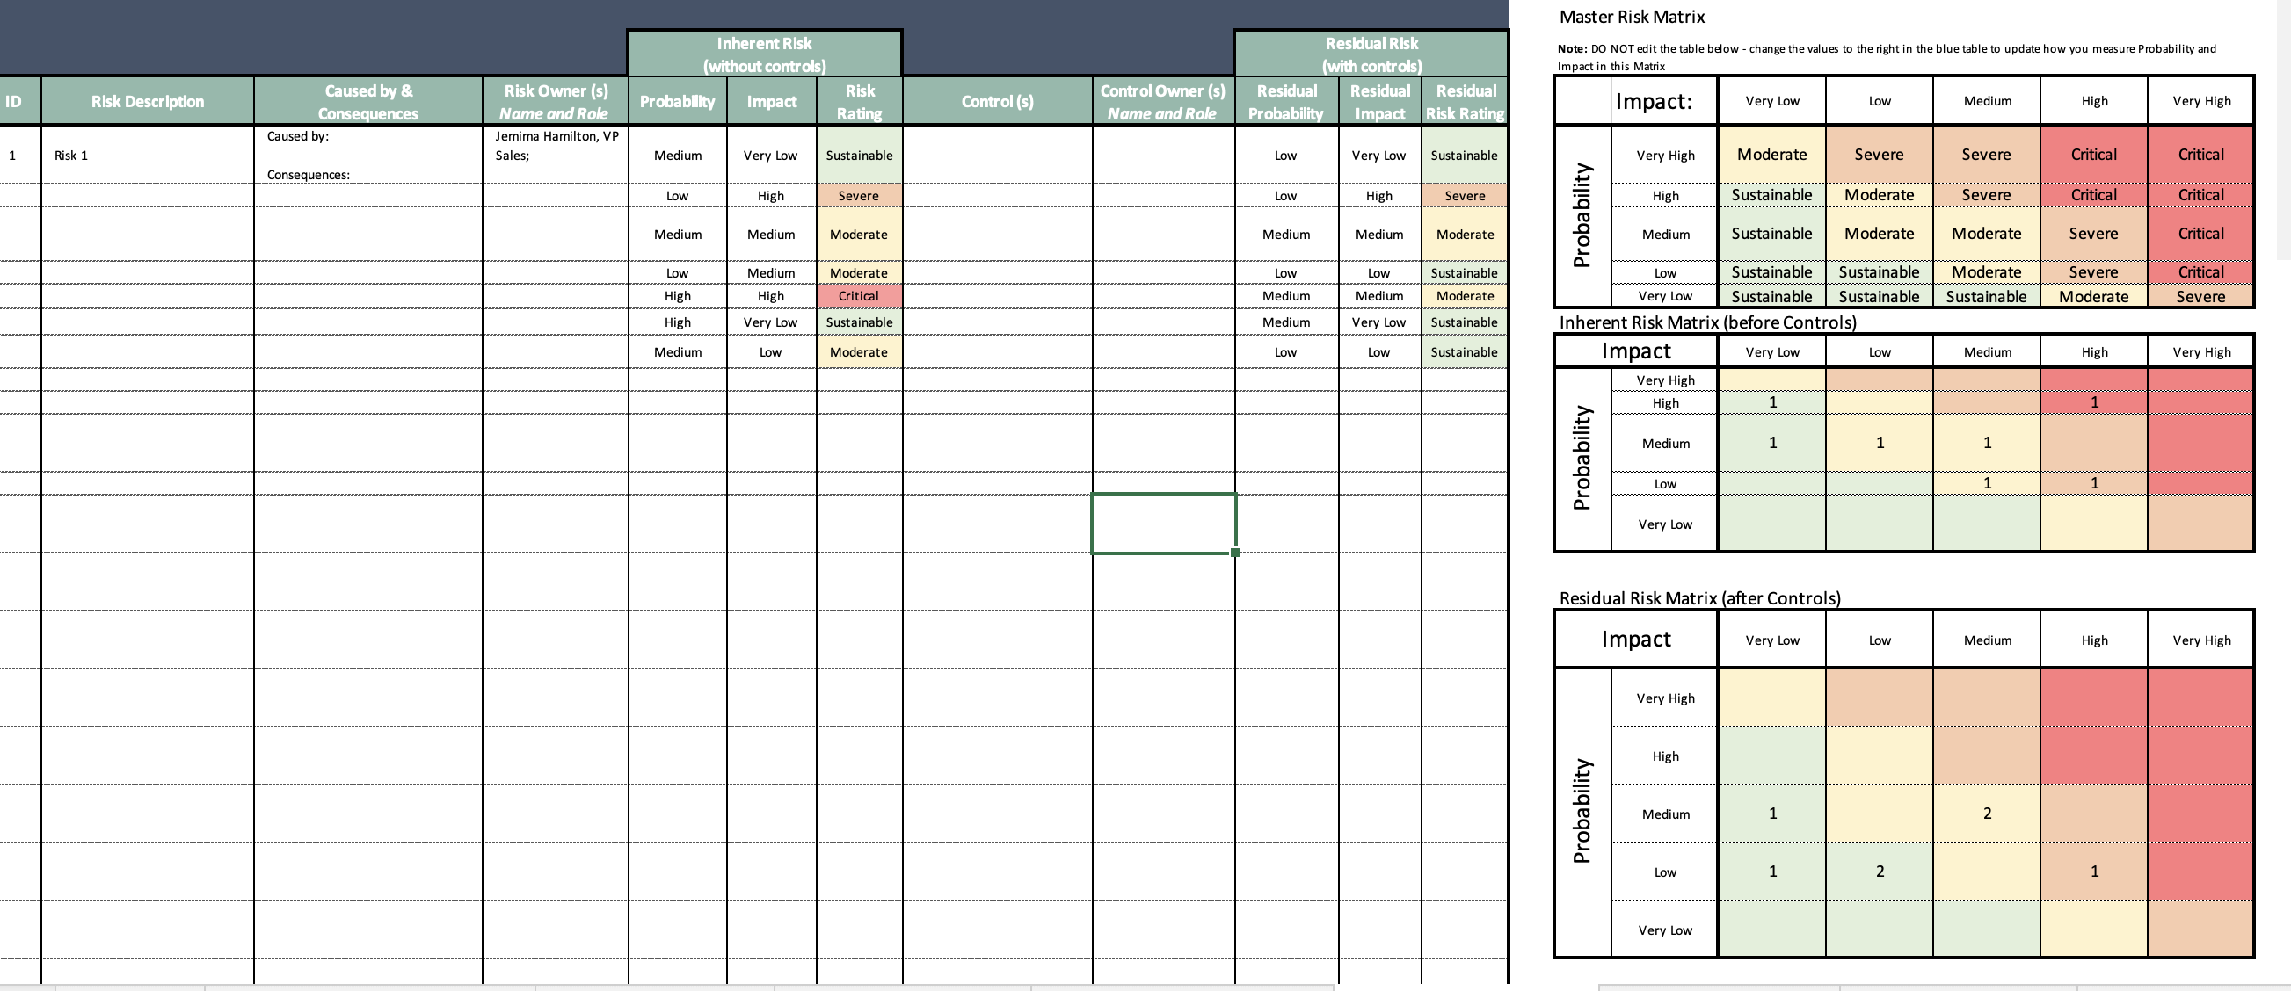
Risk Assessment

Slide 9
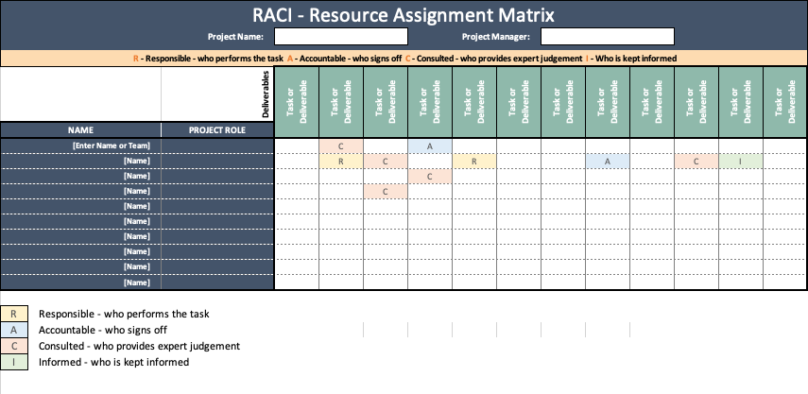
RACI

Slide 10
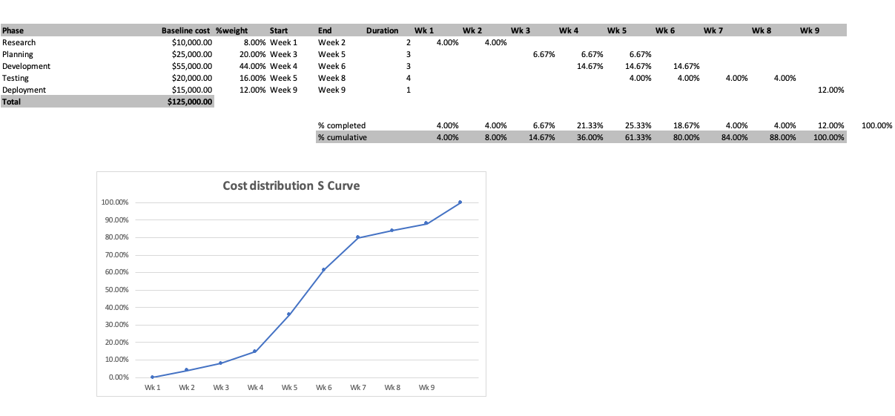
Cost distribution s curve

Slide 11
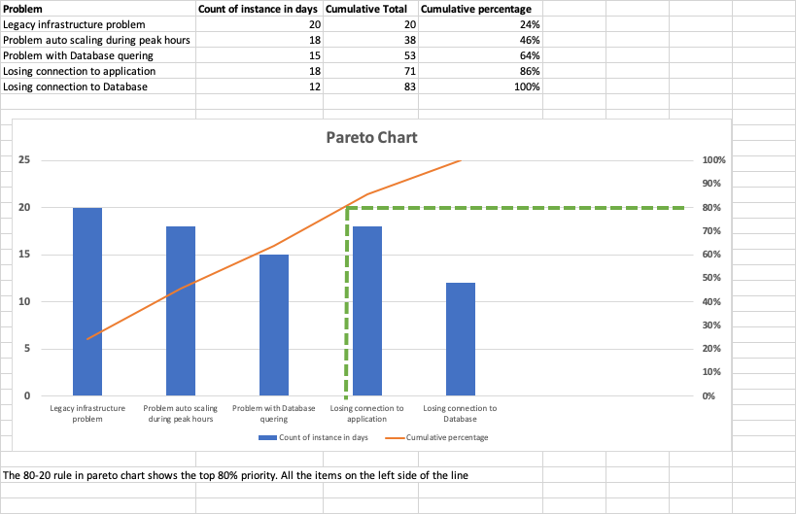
PARETO CHART

Slide 12
Gauge chart

Slide 13
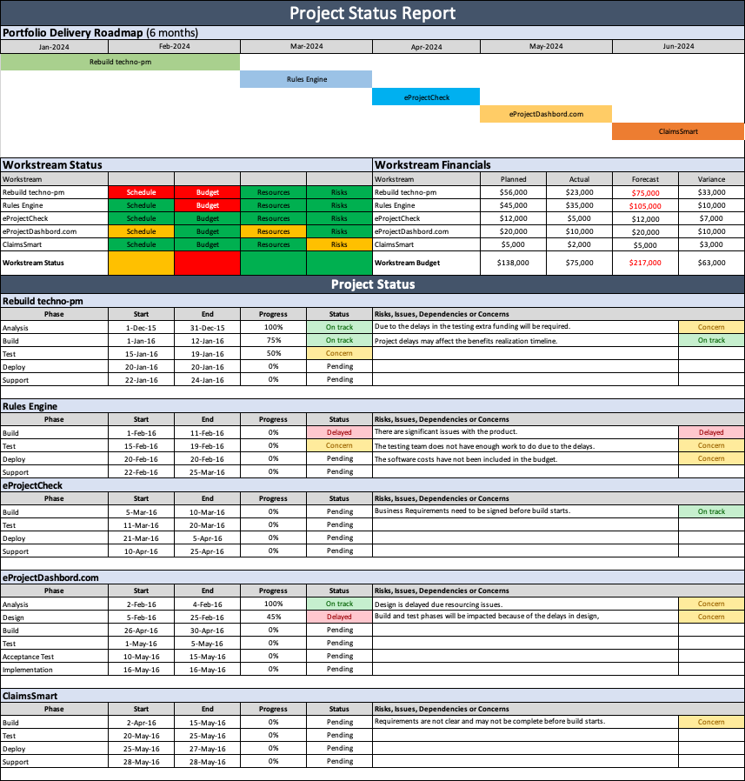
Detailed project status report

Slide 14
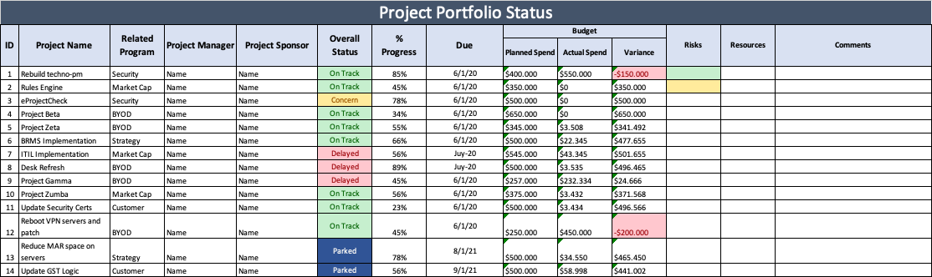
Project Portfolio status

Slide 15
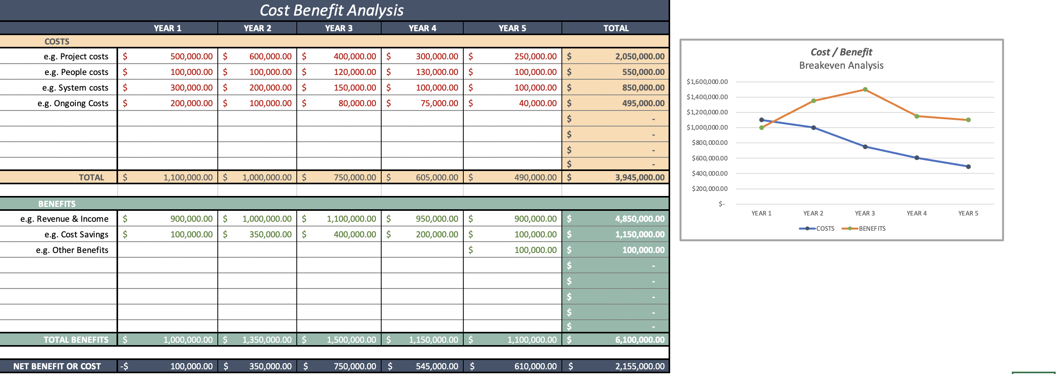
Cost Benefit Analysis

Slide 16
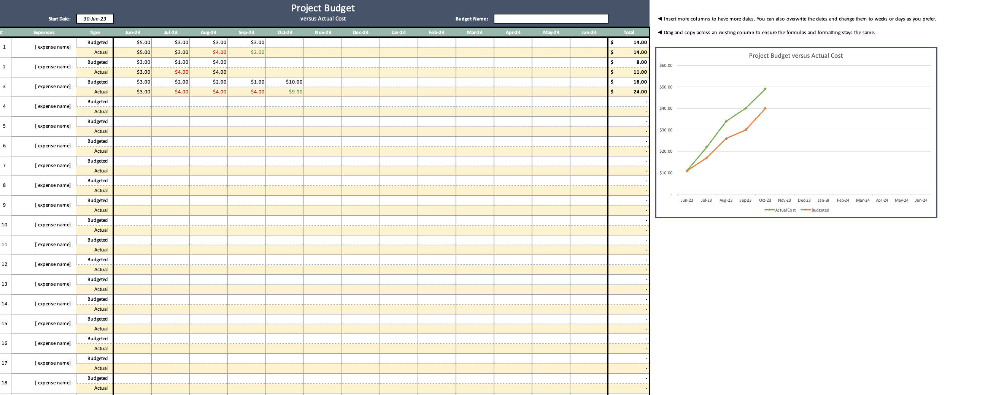
Project costs

Slide 17
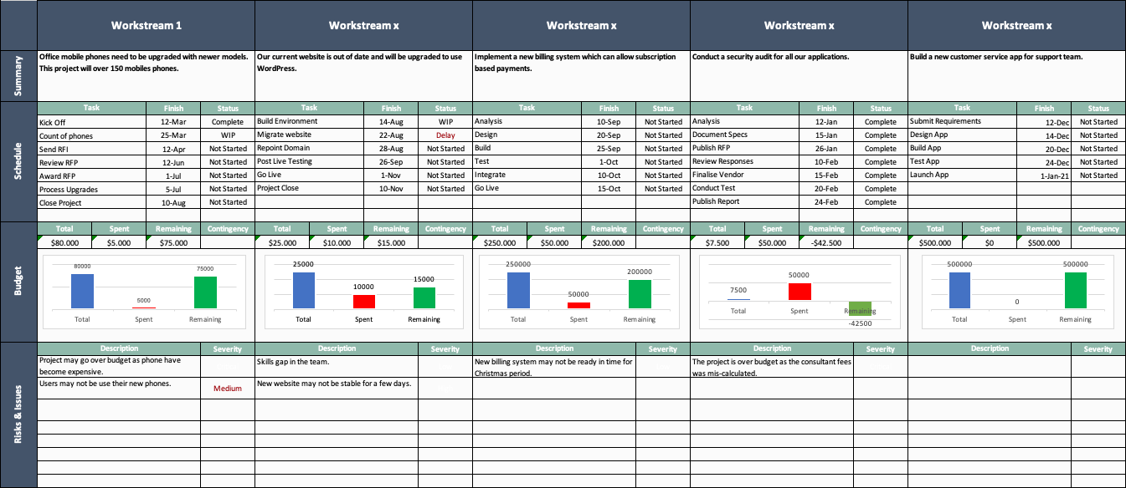
Workpackage expense Dashboard

Slide 19
Miscellaneous

Slide 20
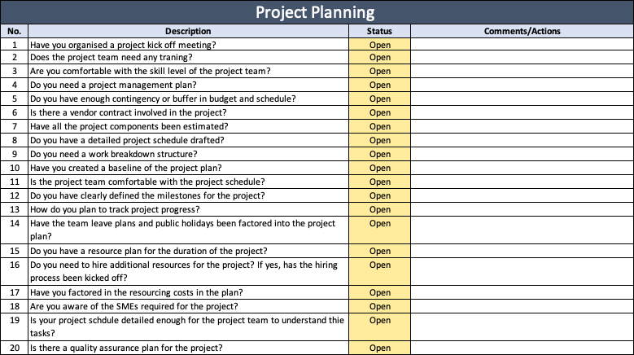
Project Planning

Slide 21
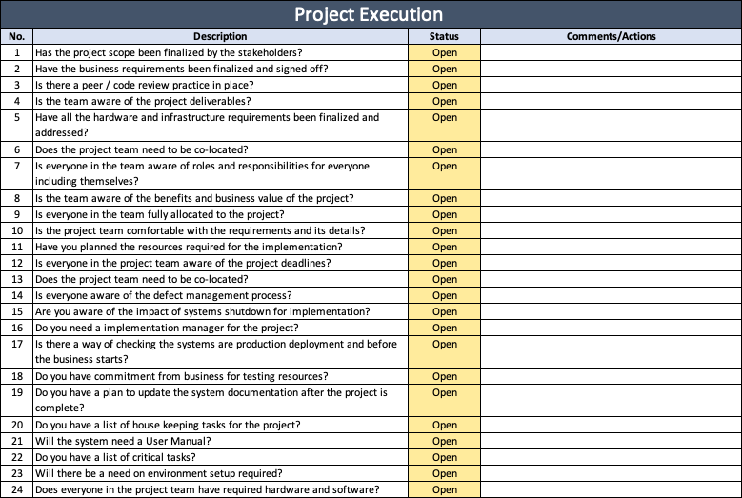
Project execution

Slide 22
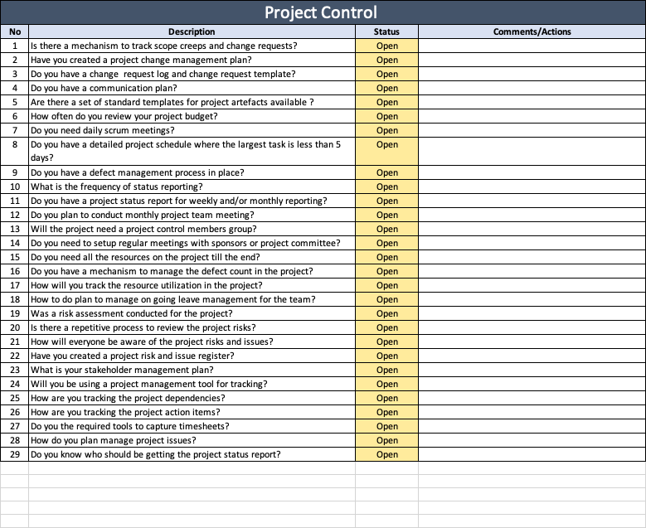
Project Control

Slide 23
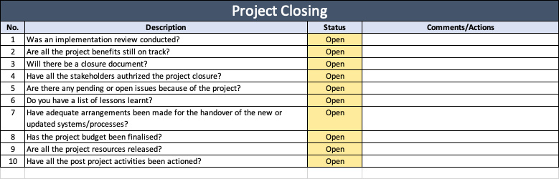
Project Closing

